Slide 1
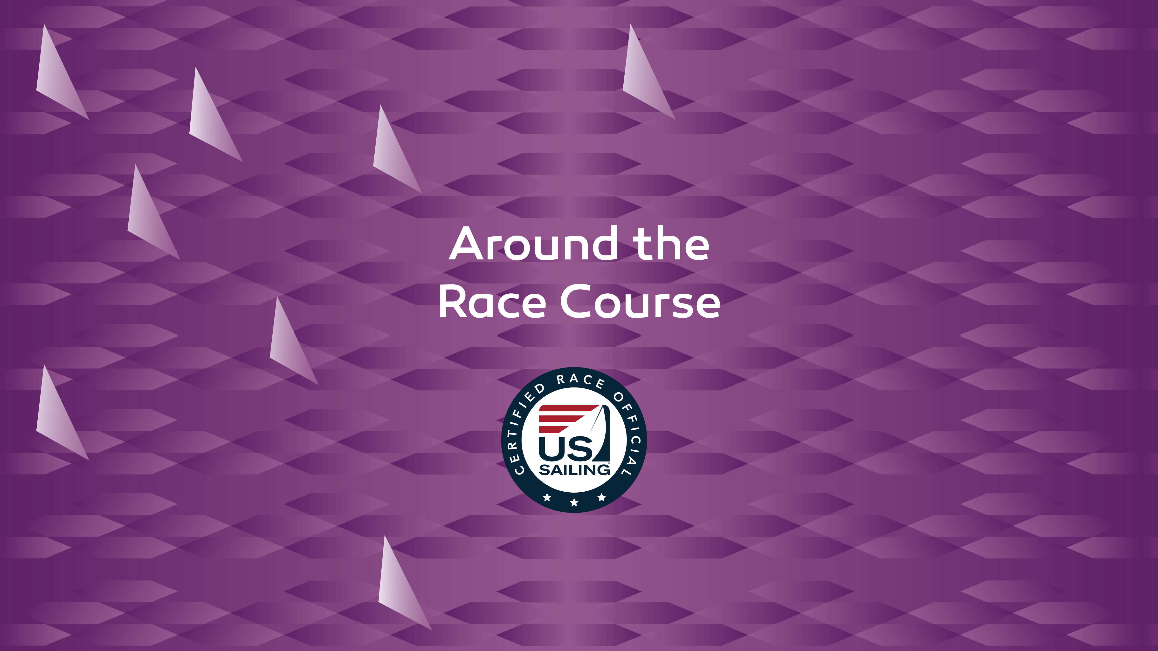
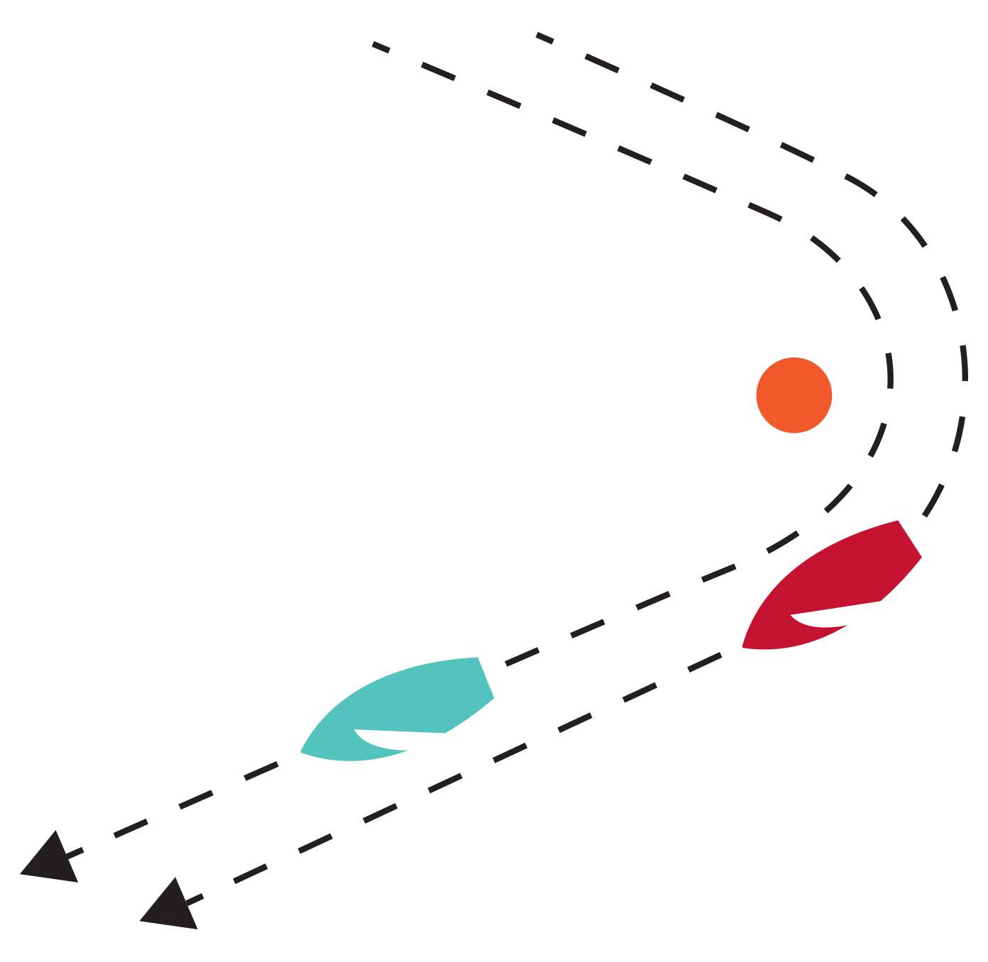

Slide 2

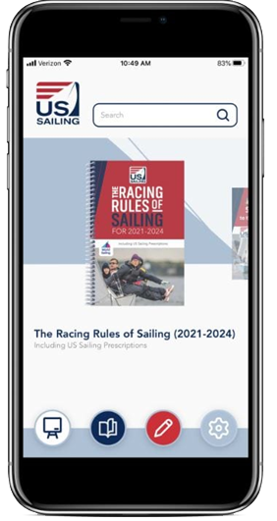
US Sailing Presents…
RRS Part 2:
Around the Race Course with
The Racing Rules of Sailing

Slide 3
Around the Course
What This Covers
Key Definitions for Judging
How do the RRS fit together around the race course?
How do the rules that apply change as the situation changes?

Slide 4
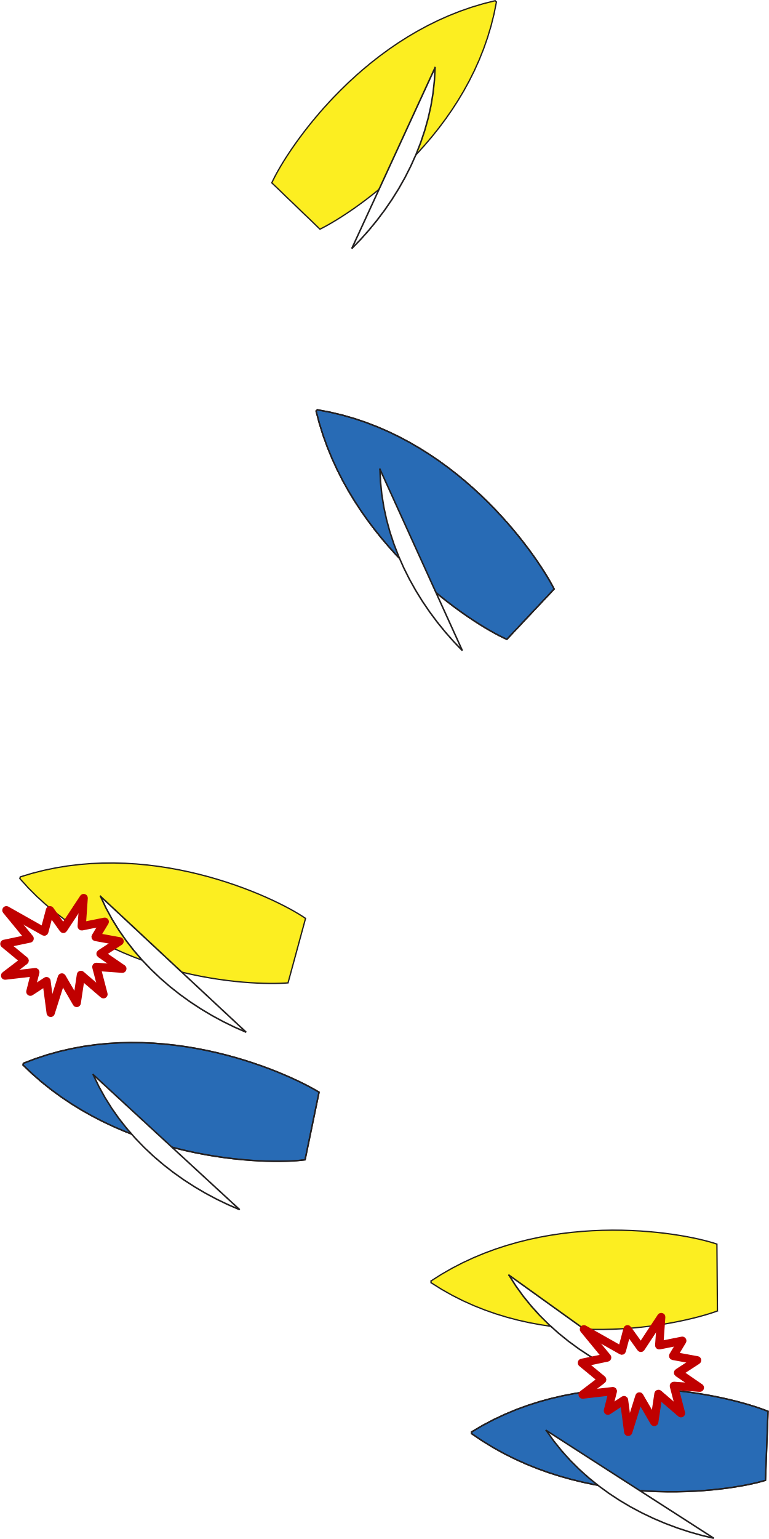

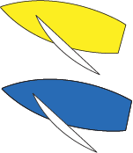


Key Definitions
Keep Clear
  A boat keeps clear of a right-of-way boat
  if the right-of-way boat can sail her course with no need to take avoiding action and,
  when the boats are overlapped, if the right-of-way boat can also change course in both directions without immediately making contact.

Slide 5
Key Definitions
Room
The space a boat needs in the existing conditions, including space to comply with her obligations under the rules of Part 2 and rule 31, while maneuvering promptly in a seamanlike way.
  Space a boat needs – bigger faster boats need more room
  Existing conditions – big waves, strong winds, current…or really light air
  Promptly – with little or no delay; immediately
  Seamanlike –befitting a competent seaman
  Includes ability to comply with rules of Part 2 and rule 31.

Slide 6
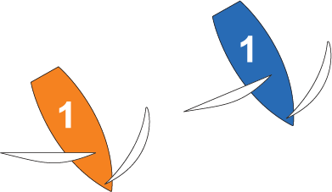
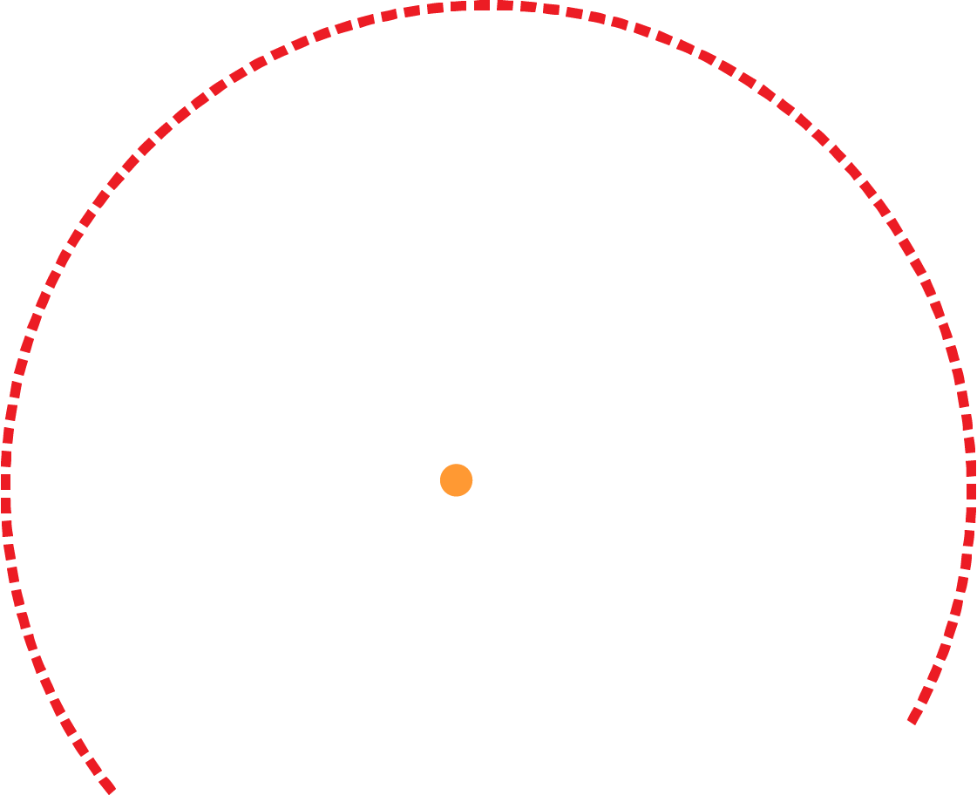
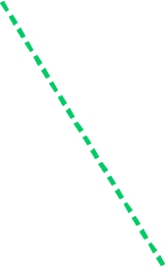

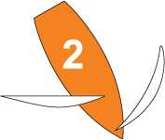
Key Definitions
Mark-Room
  Room for a boat to leave a mark on the required side.
Orange must give mark-room from this point

Slide 7
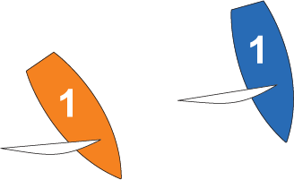






Key Definitions
Mark-Room
(a) Room for a boat to sail TO the mark when her proper course is to sail close to it, and...
Orange must give mark-room from this point.
CASE 118 - ‘room to sail to the mark’ means space to sail promptly in a seamanlike way to a position close to, and on the required side of, the mark.

Slide 8
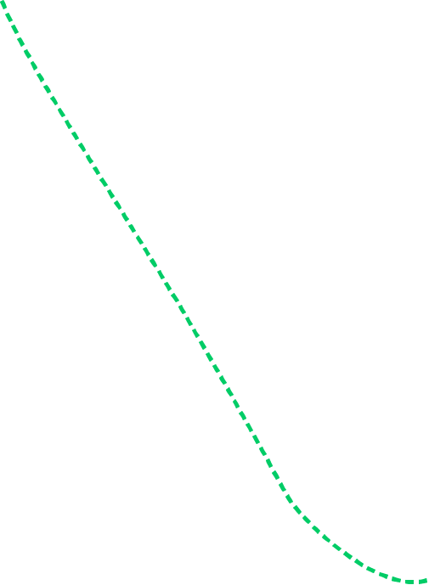

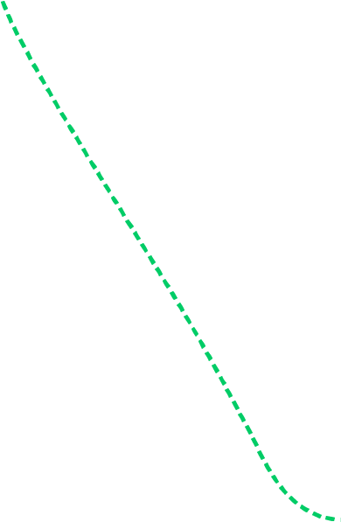





Key Definitions
Once at the mark, Blue is entitled to space to round the mark.
Not proper course!
Mark-Room
  (b) room to round the mark as necessary to sail the course.

Slide 9
Tip: Rule Deconstruction
Rule 10: On Opposite Tacks
  “When boats are on opposite tacks, a port-tack boat shall keep clear of a starboard-tack boat.”
  Tack – A boat is on the tack, starboard or port, corresponding to her windward side.
  Leeward and Windward – A boat’s leeward side is the side that is or, when she is head to wind, was away from the wind. However, when sailing by the lee or directly downwind, her leeward side is the side on which her mainsail lies. The other side is her windward side…
  Keep Clear – A boat keeps clear of a right-of-way boat: (a) if the right-of-way boat can sail her course with no need to take avoiding action…
  When boats are on opposite tacks, a port-tack boat shall allow a starboard-tack boat to sail her course with no need to take avoiding action.

Slide 10
Key Definitions
Obstruction
An object that a boat could not pass without changing course substantially, if she were sailing directly towards it and one of her hull lengths from it.
An object that can be safely passed on only one side and an object, area or line so designated by the sailing instructions are also obstructions.
However, a boat racing is not an obstruction to other boats unless they are required to keep clear of her or, if rule 22 applies, avoid her.
A vessel underway, including a boat racing, is never a continuing obstruction.

Slide 11

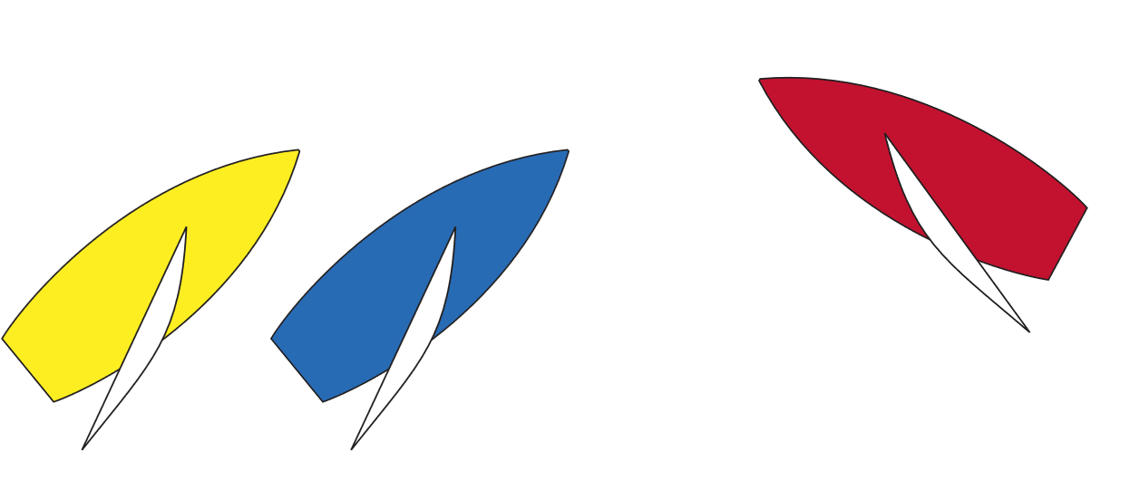
Key Points About Obstructions
  The object must be large enough to require a substantial course change to avoid if you were sailing towards it.
  The amount of course change required is determined from a point one-boat length from the object.
  The size of course change must be substantial.
Notes:
.

Slide 12
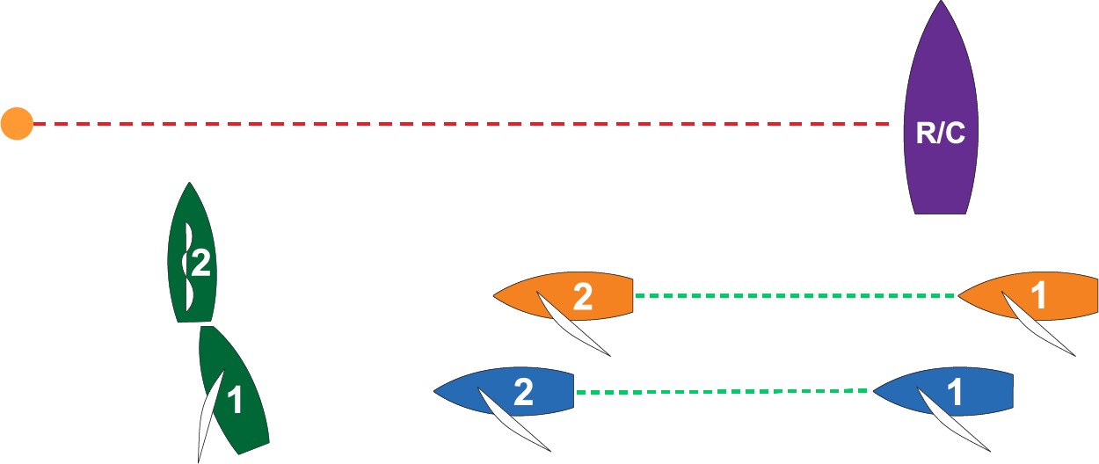






Starting Area
Questions
Is Green an obstruction?
Who has what rights?
What rules apply?

Slide 13
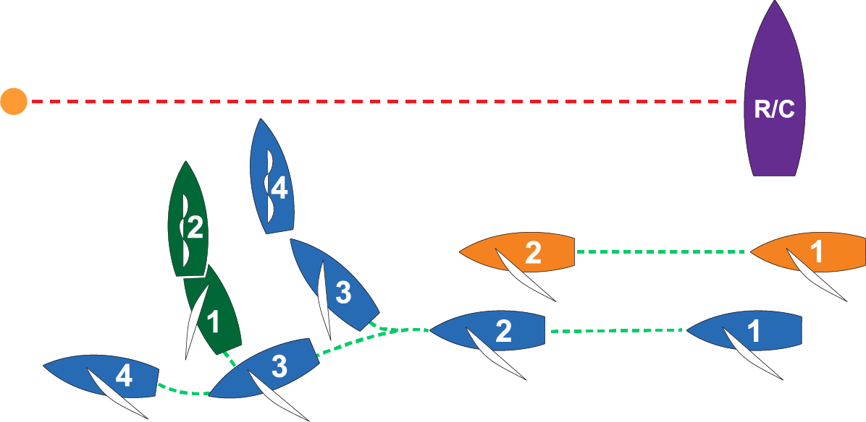
Starting Area
As leeward right-of-way (RoW) boat, Blue gets to decide which side of Green she wants to sail on.

Slide 14
Starting Area
Does Orange have the right to ask for room?
Blue! I want ROOM to duck this obstruction…
No.
Green is an obstruction, so RRS 19.2 (a) applies.
Blue (RoW) may choose the side on which to pass the obstruction.

Slide 15
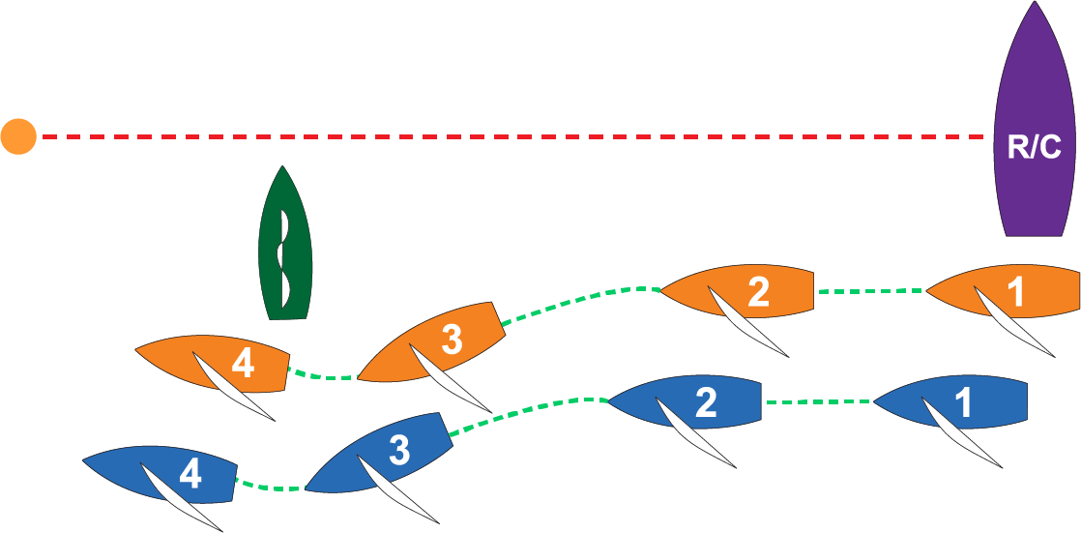










Starting Area
What happens once Blue decides to go to leeward of Green?
Rule 19 applies…
  Green is not a mark of the course (rule 19.1).
Rule 19.2(b) – Overlapped
  Blue (outside) shall give Orange (inside) room.

Slide 16







Starting Area
Is Green entitled to room to pass between Blue & Orange?
Blue is an obstruction as both Orange (windward – rule 11) and Green (same tack, clear astern – rule 12) are required to keep clear of Blue.
Blue is NOT a continuing obstruction. (def. obstruction)

Slide 17
Starting Area
Is Green entitled to room to pass between Blue & Orange?
It depends…
Caveats
When Green overlaps Orange and gains RoW she must initially give Orange room to keep clear (rule 15).
Orange must keep clear and give Green room to pass between her and Blue if she is able to when the overlap begins (rules 11 and 19.2(b)).

Slide 18
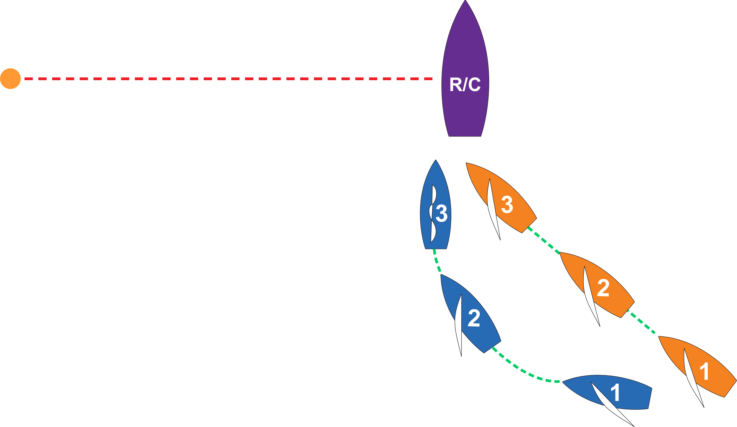
The Start
Prior to starting signal…
Boats approaching line to start.
  What is happening?
  What rules apply?
  Who has what rights?
  Does the right-of-way boat have any limitations?

Slide 19
The Start – “Barging”
Prior to starting signal…
Part 2, Section C Preamble
    Section C rules (18, 19, & 20) do not apply at a starting mark surrounded by navigable water when approaching it to start.
Rule 11 – On the Same Tack, Overlapped
  Windward boat shall keep clear of a leeward boat.
Rule 16.1 – Changing Course
  As RoW boat changes course she shall give keep-clear boat room to keep clear.
Blue must “shut the door” before Orange is trapped by the race committee boat.
No Room!

Slide 20
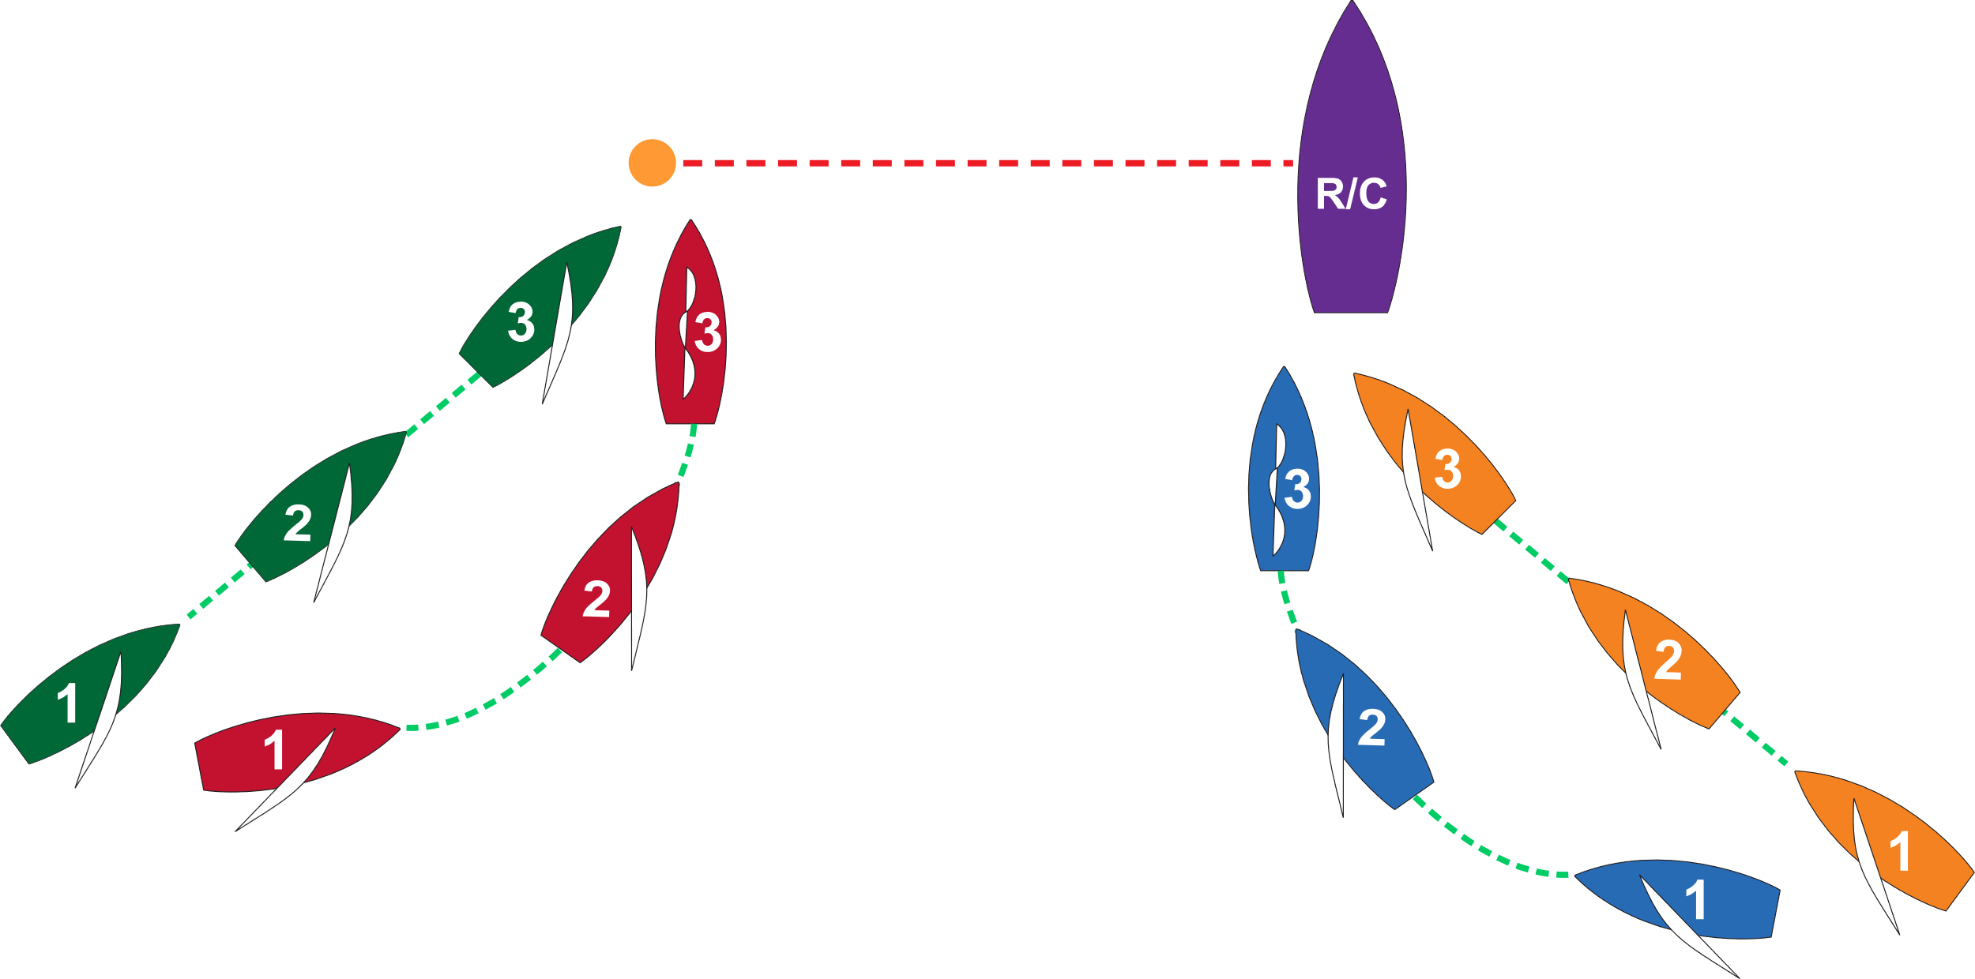
The Start – “Barging”
Prior to starting signal…
No Room!
No Room!
“Barging” can also apply at the pin-end of the starting line.

Slide 21
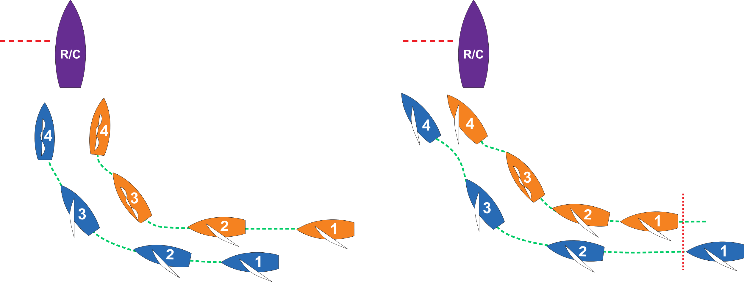
Rule 17 at the Starting Line
What about BEFORE / AFTER the starting signal?
How was the overlap established?
Is there a Rule 17 proper course limitation on the leeward boat?
Before the starting signal Blue has no proper course, but after the starting signal Blue may be required by rule 17 to sail her proper course, depending on how the overlap was established.

Slide 22
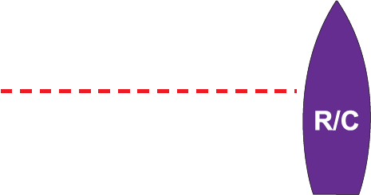

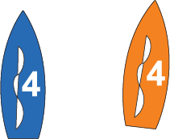


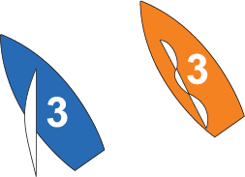
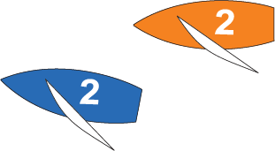
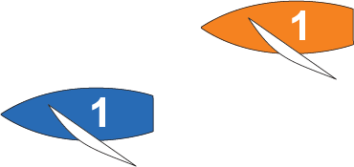
Rule 17 at the Starting Line
The rules that apply change as the situation changes…
Rule 17 – On the Same Tack; Proper Course
Blue (leeward) did not establish the overlap from clear astern of Orange. Blue is not bound by Rule 17 and may sail above her proper course.
Start Signal: +0.02
Start Signal: 0.00
Rule 11 – On the Same Tack, Overlapped
Orange (windward) shall keep clear of Blue.
Rule 12 – On the Same Tack, Not Overlapped Orange (clear astern) shall keep clear of Blue.
Rule 16 – Changing Course
Blue (RoW) shall give
Orange room to keep clear.

Slide 23
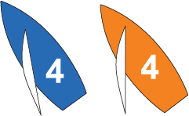
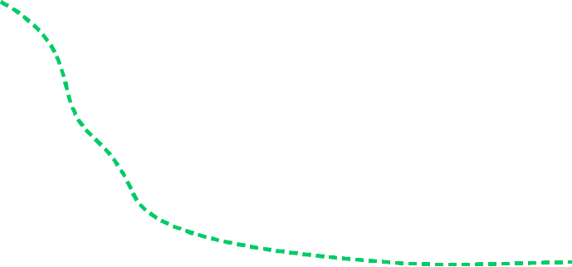

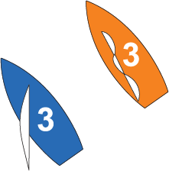
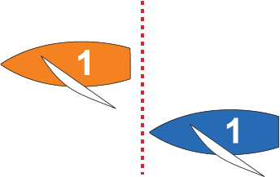
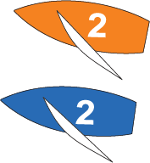
Rule 17 at the Starting Line
The rules that apply change as the situation changes…
Rule 17 – On the Same Tack; Proper Course
Blue (leeward) established the overlap on Orange from clear astern. Blue is required by rule 17 to sail her proper course after the starting signal.
Start Signal: +0.02
Rule 11 – On the Same Tack, Overlapped
Orange (windward) shall keep clear of Blue.
Start Signal: 0.00
Rule 16 – Changing Course
Blue (RoW) shall give
Orange room to keep clear.
Rule 12 – On the Same Tack, Not Overlapped Blue (clear astern of Orange) shall keep clear of her.
Rule 15 – Acquiring Right of Way
Blue (RoW) shall initially give Orange room to keep clear.

Slide 24
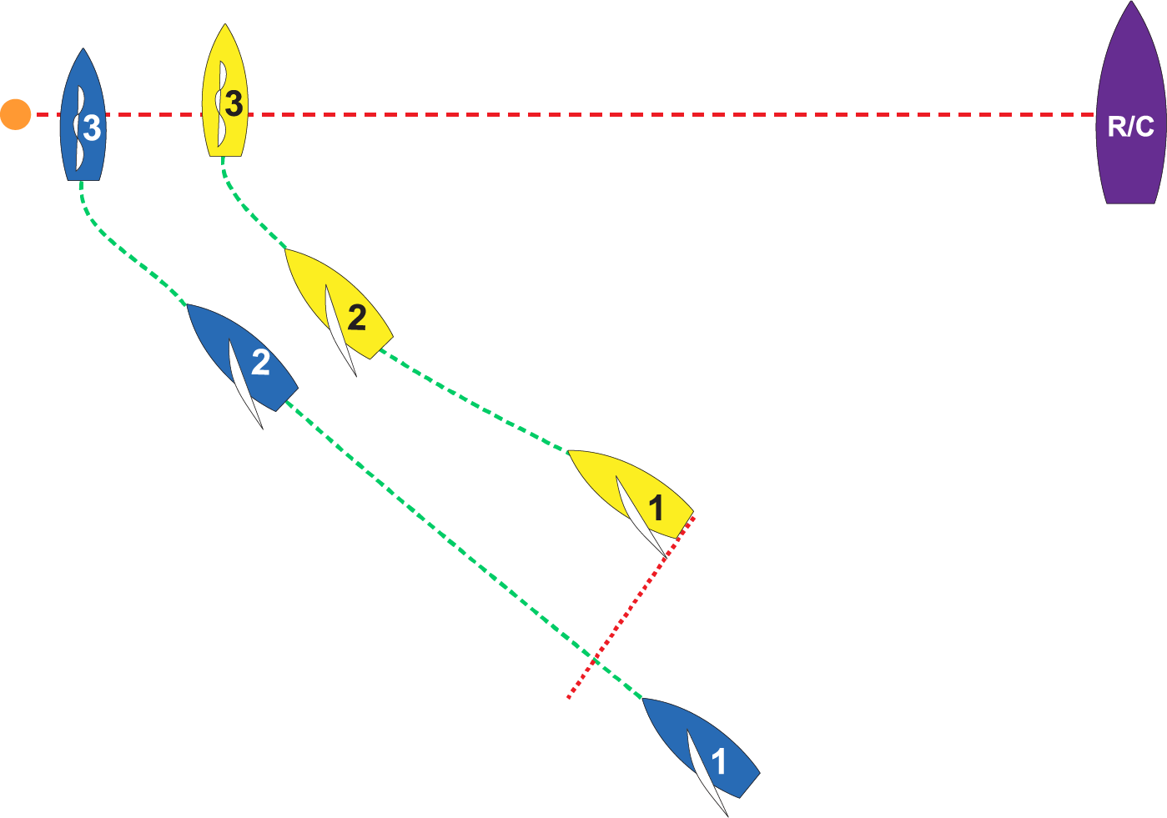
The Start
What is Blue’s Proper Course?
After the starting signal, Blue (leeward) may not sail above her proper course (rule 17) which, when sailing to windward, is usually close-hauled.
However, in order to pass on the correct side of the starting mark, Blue’s proper course may be to momentarily luff up to head-to-wind (def. Proper Course).
Yellow must keep clear of Blue (rule 11), but while Blue is changing course, she must give Yellow room to do so (rule 16).

Slide 25
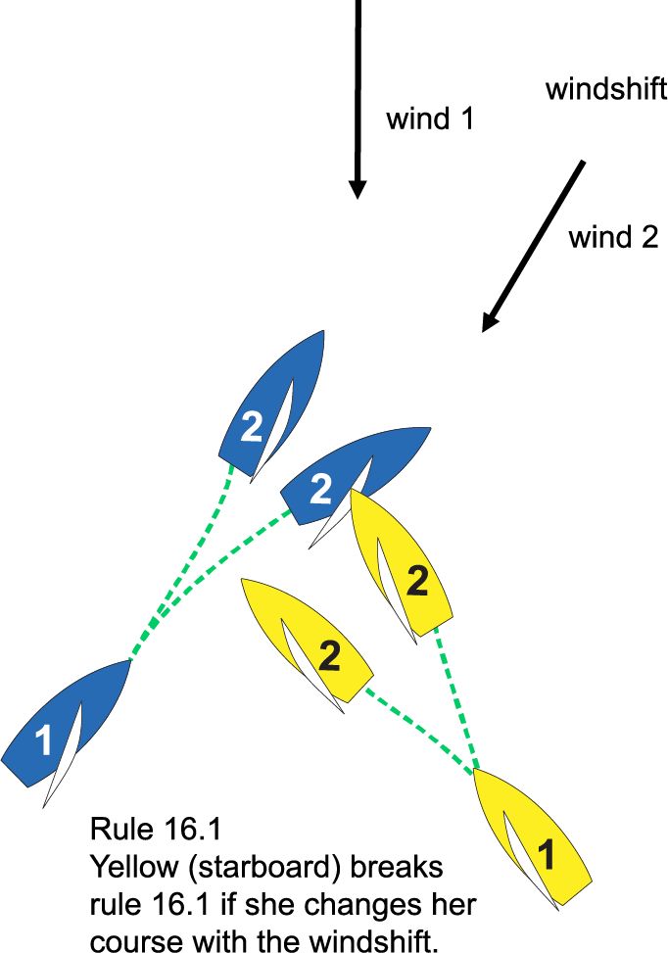
Windward Legs
Rule 10: Port must keep clear.
Rule 16.1: Protects the keep clear boat from the right-of-way boat’s unpredictable or last-second changes of course, which would prevent port from keeping clear.
Possible conclusions:
Port kept clear
Port did not keep clear
Starboard did not give room while changing course…
Rule 16.1
Yellow (starboard) breaks rule 16.1 if she changes her course with the windshift and does not give Blue room to keep clear.

Slide 26
Windward Legs
So how close is too close?
On a two-lane road, when wanting to pass, it depends…
  Are you driving a race car or a tractor?
  What are you passing?
  What’s coming in the opposite direction?

Slide 27
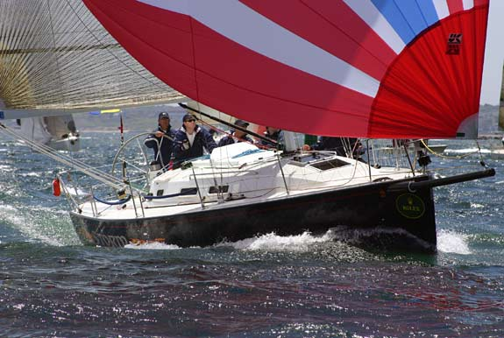
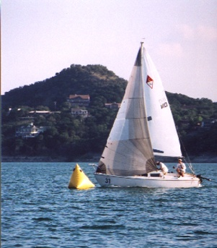
Windward Legs
So how close is too close?
In sailboat racing it also depends on…
  Distance between boats
  Speed of boats
  Size, maneuverability of boats
  Visibility between boats
  Angle of convergence
These are the key facts needed to reach a conclusion.

Slide 28
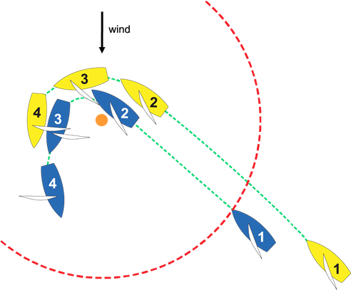
Windward Mark
Not overlapped at the zone (3 hull lengths)
Yellow must give Blue mark-room, which includes room for Blue to bear away to the course needed to begin sailing the next leg (def. mark-room).
Rule 18 applies until Blue either has been given mark-room, passes head to wind, or leaves the zone.

Slide 29
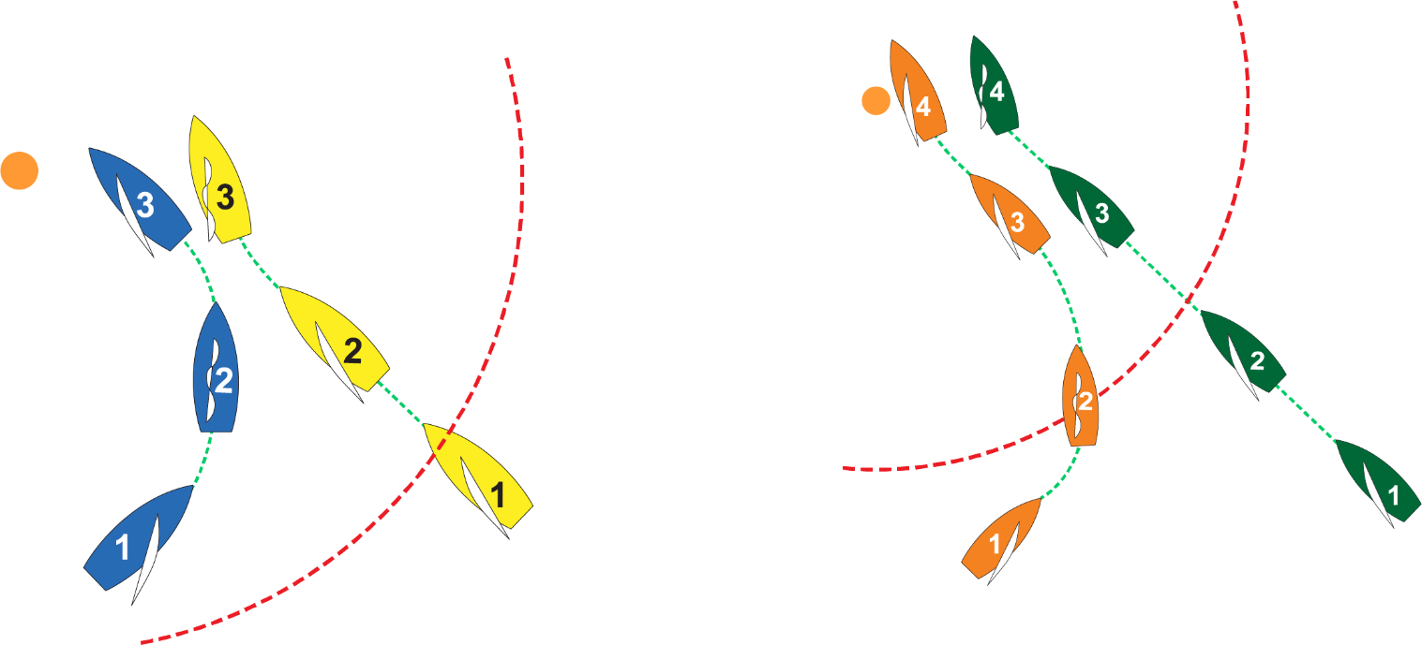
Windward Mark
Rule 18.3 – Tacking When Approaching a Mark to be left to Port
  Blue and Orange (port) pass head to wind from port to starboard in the zone and are then fetching the mark.
  Yellow and Green (starboard) have been sailing on starboard since entering the zone.
  Blue and Orange break rule 18.3 by causing Yellow and Green to sail above close-hauled to avoid contact.

Slide 30
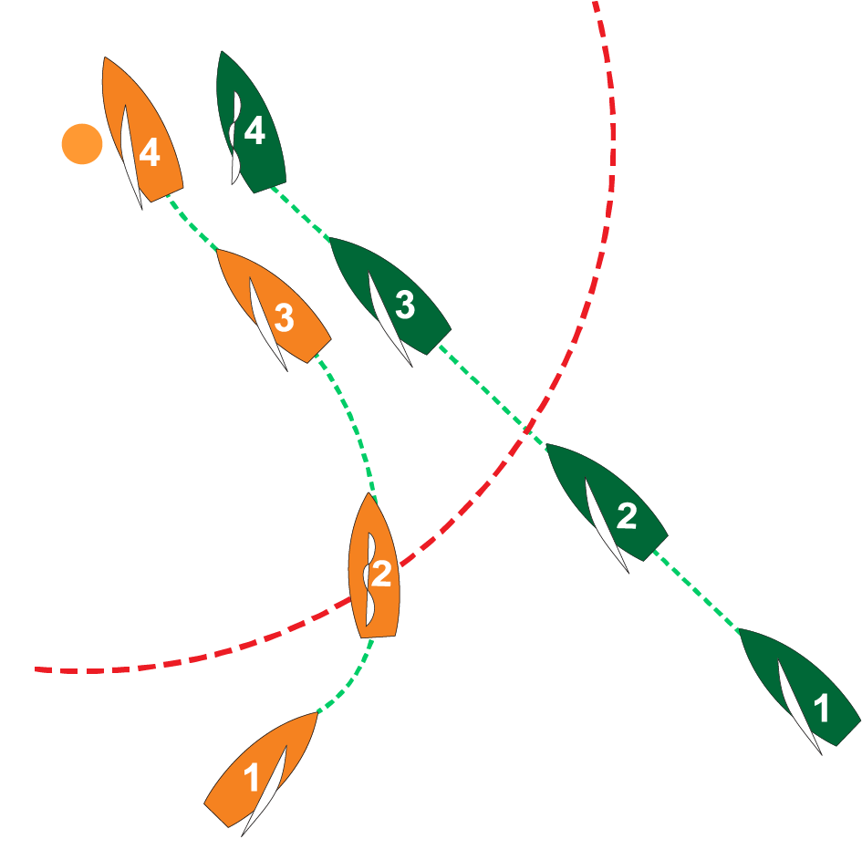
Windward Mark
Rule 18.3 – Tacking When Approaching a Mark to be Left to Port.
In position 4, Orange luffs above close-hauled to clear the mark. As a result of her luff, Green sails above close-hauled to avoid Orange. Orange breaks rule 18.3.
Rule 11 – Same Tack, Overlapped
Orange is leeward boat.
Rule 13 - While Tacking
Orange passes head to wind and becomes subject to rule 13 until she reaches a close-hauled course.
Rule 10 – On Opposite Tacks

Slide 31
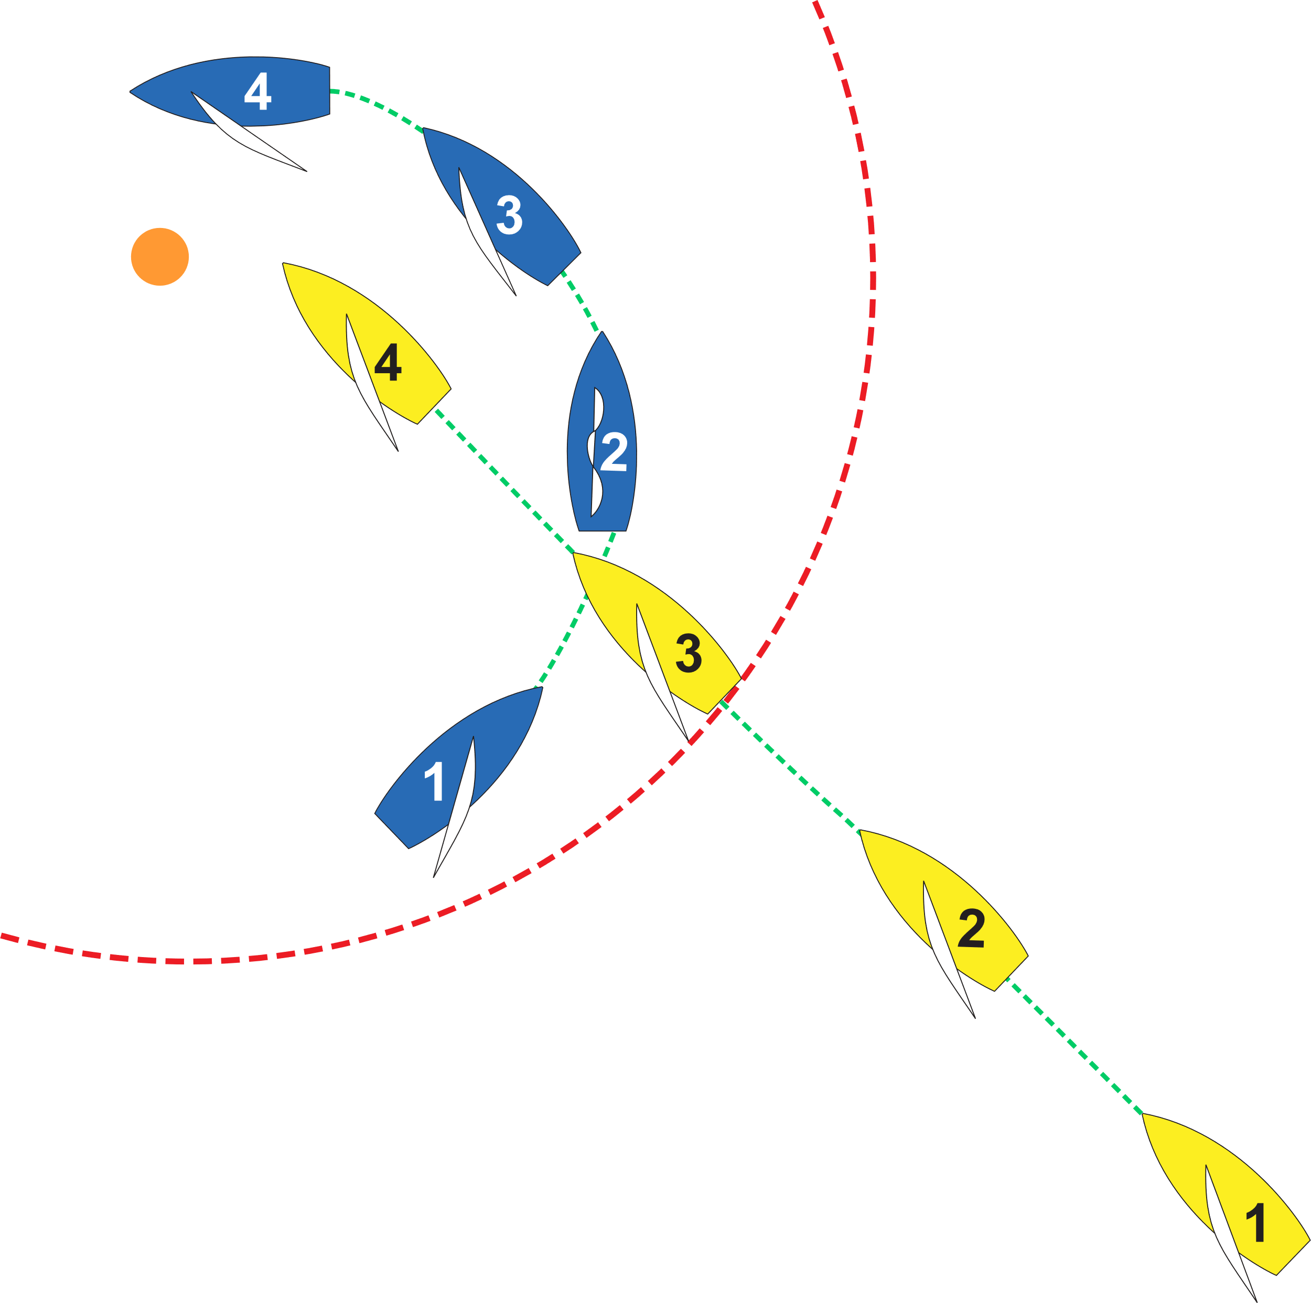
Windward Mark
Rule 18.3 – Tacking When Approaching a Mark to be Left to Port.
  Blue passes head to wind from port to starboard in the zone and is then fetching the mark
  Yellow entered the zone on starboard and has remained on starboard.
Rule 18.3 applies; therefore rule 18.2 does not:
  Yellow becomes overlapped inside of Blue just prior to position 4.
  Blue must give mark-room to Yellow.

Slide 32
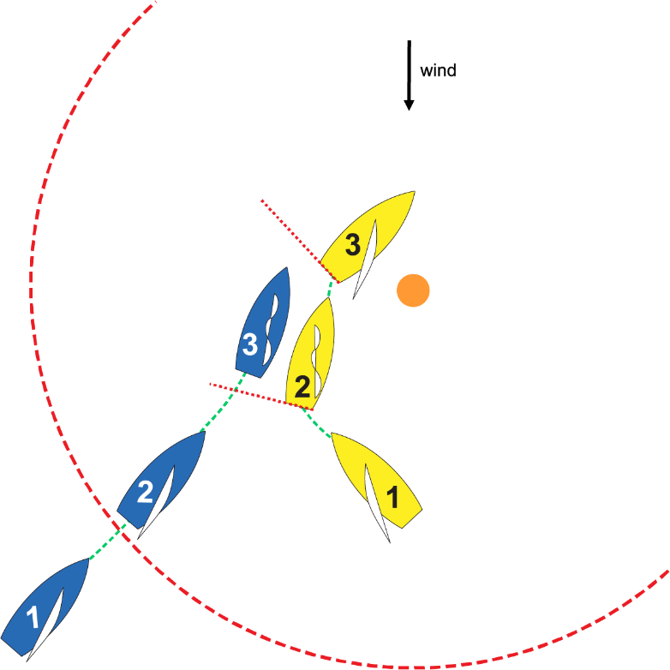
Windward Mark
Starboard Rounding
Blue and Yellow are approaching the windward mark to be rounded to starboard. Blue, on port, is fetching the mark. Yellow, on starboard, tacks from starboard to port clear ahead of Blue (position 2) and gets down to close-hauled just prior to position 3. Blue luffs to avoid hitting Yellow’s stern (position 3).
Who has right-of-way and what rules apply?
At position 1?
• Yellow (rule 10 – starboard)
At position 2?
• Blue (rule 13 – tacking)
(rule 15 - acquiring RoW does not apply)
At position 3?
• Yellow (rule 12 – clear ahead)
(rule 15 - acquiring RoW)
(rule 18.3 –tacking in the zone - does not apply at starboard roundings)

Slide 33
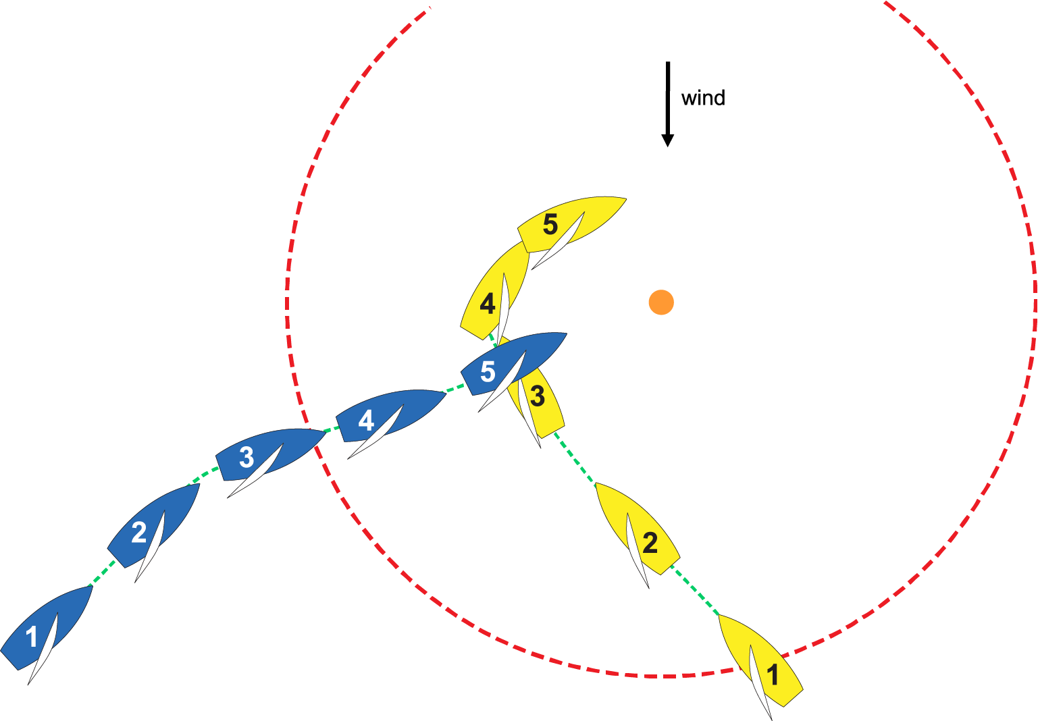
Windward Mark
Starboard Rounding
Blue and Yellow are approaching the windward mark to be rounded to starboard. Blue, on port, is fetching the mark. Yellow, on starboard, tacks from starboard to port clear ahead of Blue (between positions 3 & 4) and gets down to close-hauled just after position 4. Blue starts to duck at position 3 and obtains an inside overlap at just before position 5.
Who has right-of-way and what rules apply?
At position 3?
• Yellow (rule 10 – starboard)
(rule 16 – changing course)
At position 4?
• Blue (rule 13 – tacking)
(rule 15 – acquiring RoW does not apply)
At position 5?
• Blue (rule 11 – leeward)
(rule 18.2(a) and (f) – mark-room)
(rule 18.3 – tacking in the zone –
does not apply at starboard roundings)

Slide 34
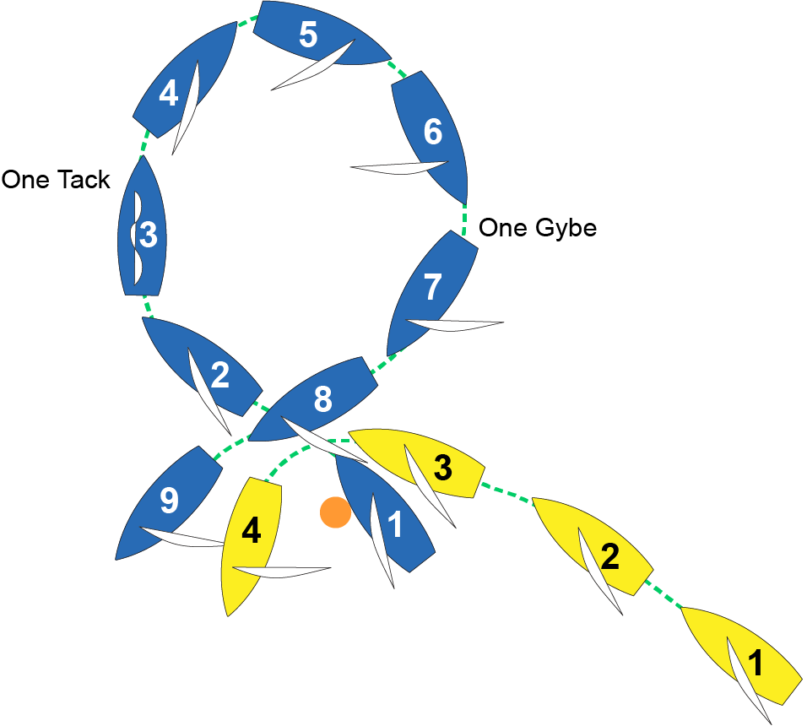
Windward Mark
Rule 31 – Touching a Mark
Rule 31 – “While racing, a boat shall not touch...a mark that begins, bounds, or ends the leg of the course on which she is sailing...”
Rule 44.1 – Blue may take a One-Turn Penalty for breaking rule 31.
Rule 44.2 – After getting well clear of other boats as soon as possible, a boat takes a penalty by making the required number of turns in the same direction, each turn including one tack and one gybe.
Rule 21.2 - Blue must keep clear of other boats while doing her penalty turn.

Slide 35
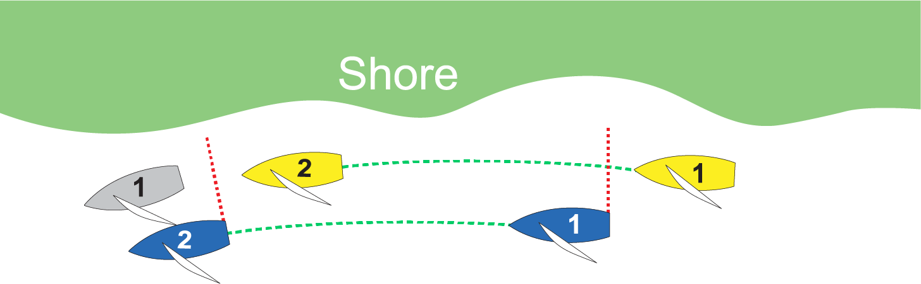
Rule 19.2 (c)
Giving Room at a Continuing Obstruction

Slide 36
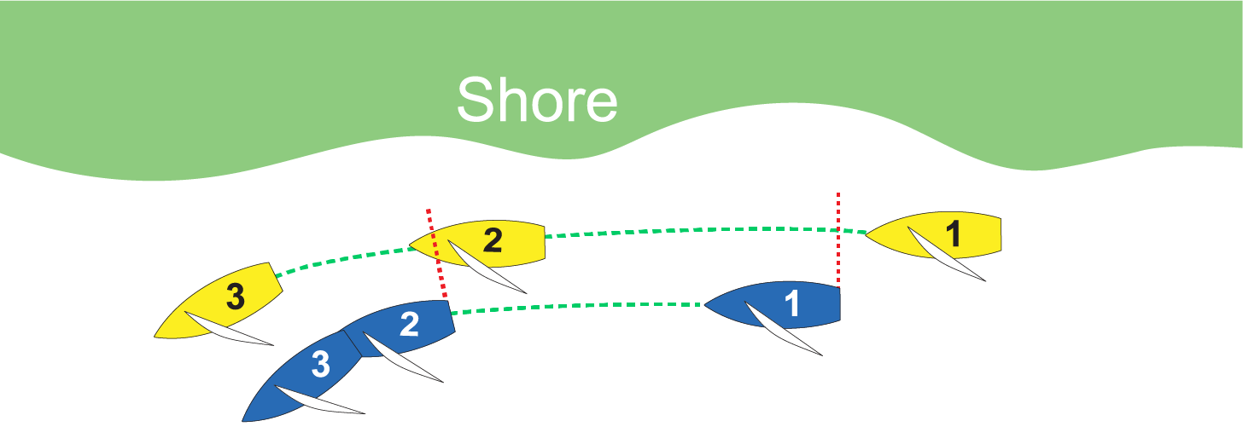
Rule 19.2 (c)
Giving Room at a Continuing Obstruction

Slide 37
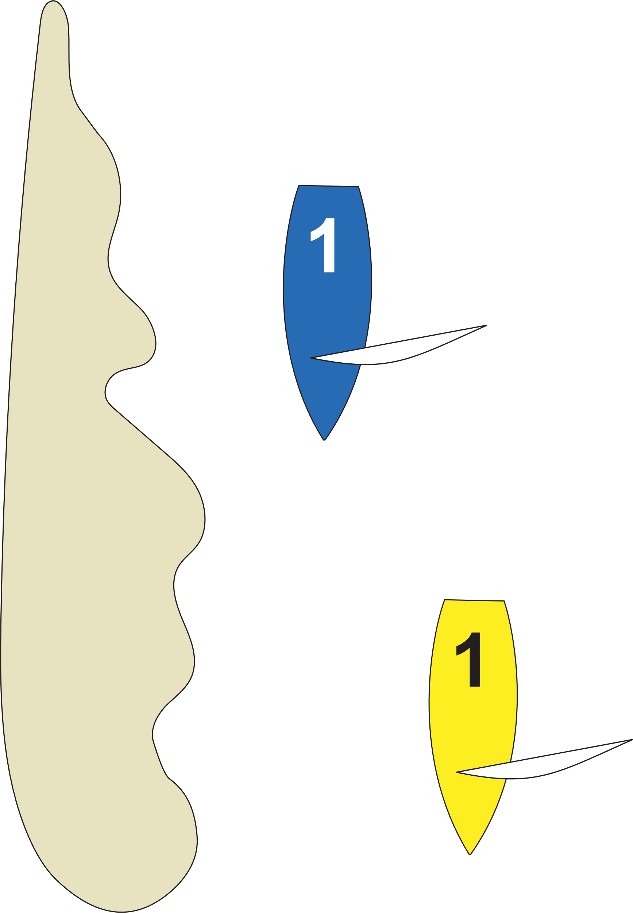
Rule 19.2 (c)
Giving Room at a Continuing Obstruction
The shore is a continuing obstruction.
Both Blue and Yellow are on starboard tack.
Blue is clear astern and required to keep clear of Yellow. (rule 12)
    Blue wants to go between Yellow and the shore but at the moment Blue overlaps Yellow, if there is not room for her to pass between Yellow and the obstruction, she is not entitled to room. (rule 19.2 (c))
  In this case Blue, with her boom out, is too wide to pass between the shore and Yellow-so she’d better not go in there.
  Would the situation be different if Yellow were on port tack?
  Yes, rule 10 would apply.

Slide 38
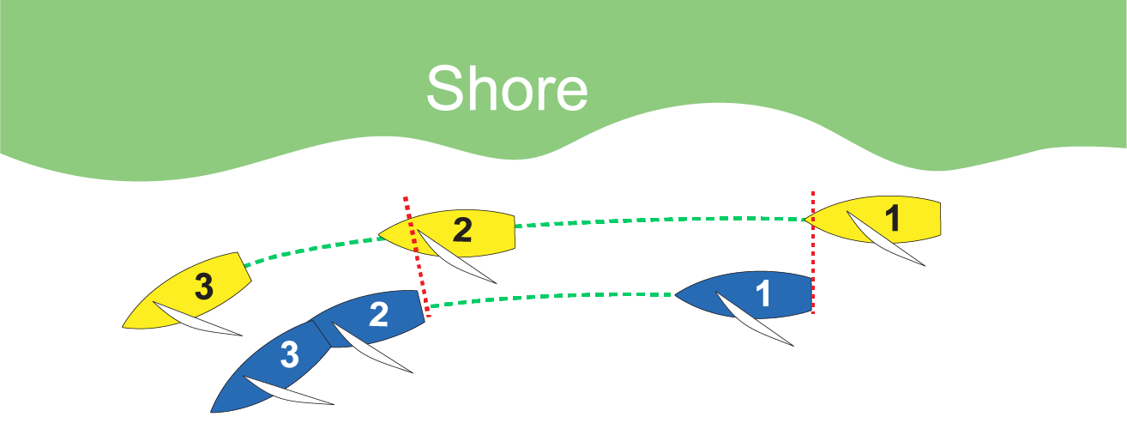
Rule 19.2 (c)
Giving Room at a Continuing Obstruction
May Yellow go between Blue & the shore?
Yes, as long as there is room for her to pass between them at the moment the overlap begins (position 1).
Is Yellow entitled to room?
If Yellow is overlapped (position 2) and needs more room to pass a point of land or shoal (position 3), Blue must bear off to provide that room.

Slide 39
Downwind Leg
Rule 17 – On the Same Tack; Proper Course
How was the overlap established?
  Did the leeward boat become overlapped from clear astern within two of her hull lengths of the windward boat?
What is proper course?
  A course a boat would choose in order to sail the course and finish as soon as possible in the absence of the other boats referred to in the rule using the term.
  A boat has no proper course before her starting signal.
  Different boats may have different proper courses at the same time.

Slide 40
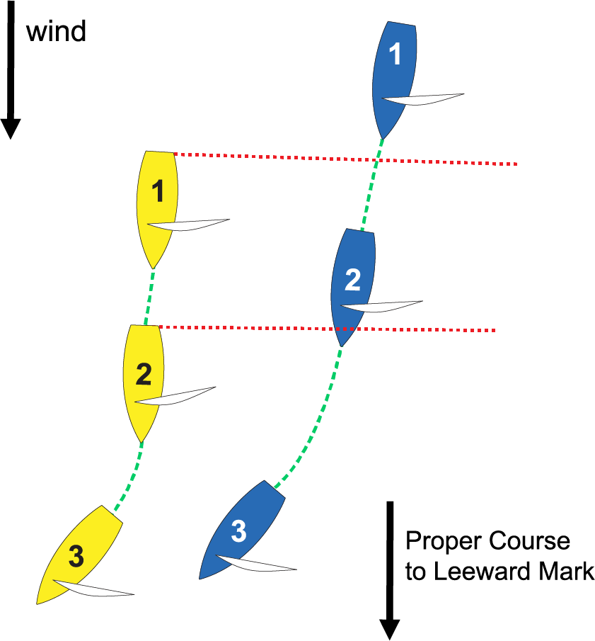
Downwind Leg
Blue became overlapped from clear astern and then luffed above her proper course. The intent was to make it difficult for Yellow to stay ahead.
In the absence of Yellow,
Blue would not luff.
Blue broke rule 17.

Slide 41
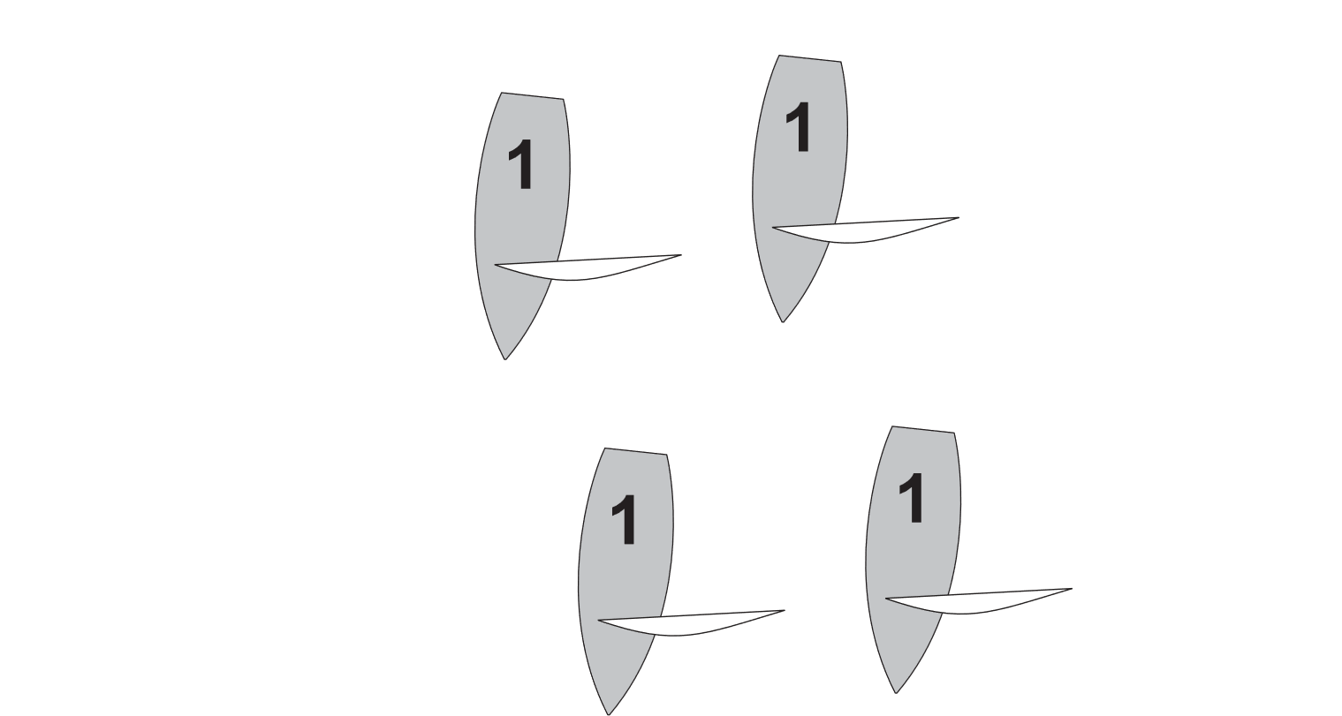
Downwind Leg
Blue became overlapped from clear astern and then sailed high to go above the slower gray boats in front of her.
In the absence of Yellow, Blue would still sail high of the gray boats.
Because she would do this even in the absence of Yellow, it is a legitimate proper course.

Slide 42
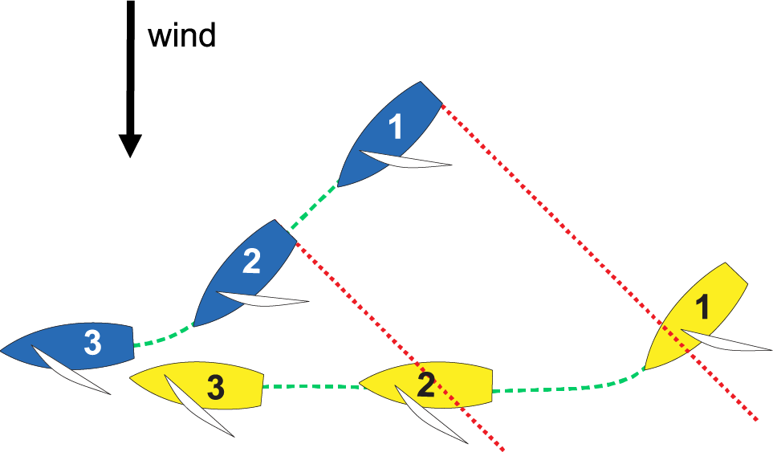
Downwind Leg
Yellow established an overlap to leeward while more than two hull lengths away from Blue.
Yellow is not restricted by rule 17 and may sail up to head to wind.

Slide 43
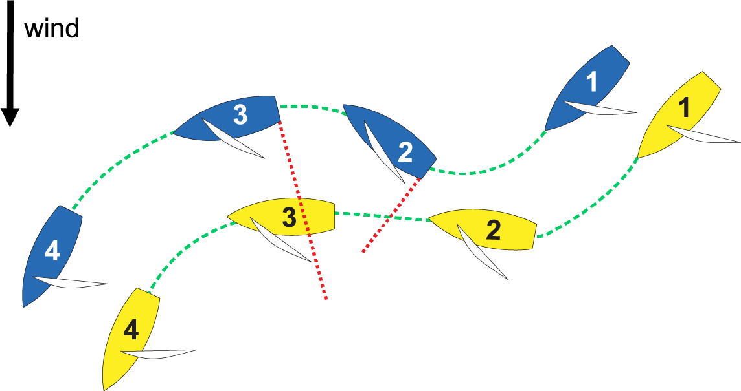
Downwind Leg
Position 1: Before reaching position 1 Blue had established an overlap to windward of Yellow
(no rule 17 restriction).
Position 2: Blue luffs hard breaking the overlap.
Position 3: Blue bears away causing the overlap to begin again. Yellow does not have to give Blue room to keep clear under rule 15 since she gained leeward right-of-way as a result of Blue’s actions.
Position 4: Yellow must promptly bear away to sail
her proper course because she obtained
her overlap from clear astern of Blue.

Slide 44
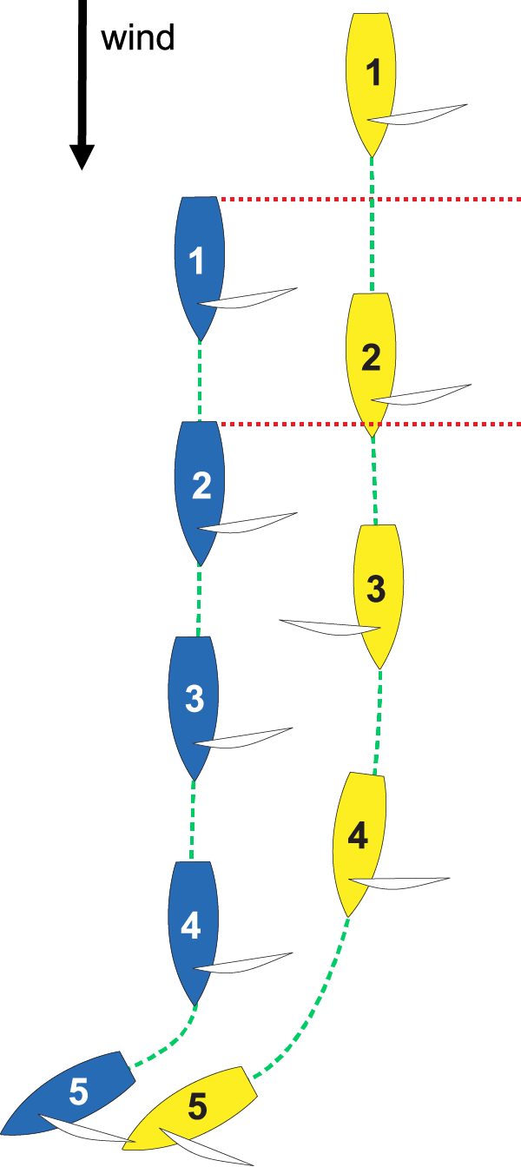
Downwind Leg
Position 1: No overlap.
Position 2: Yellow becomes overlapped to leeward of Blue from clear astern and within two hull lengths to leeward of Blue.
Position 3: Yellow gybes to port. Blue and Yellow are still overlapped because both are >90º off the wind; however, rule 17 applies only while they remain on the same tack.
Position 4: Yellow gybes back to starboard.
Position 5: Yellow may luff because at Position 4 she did not become overlapped with Blue from clear astern, so she is not restricted by rule 17. However, rule 15 requires Yellow to initially give
Blue room to keep clear. Then, as she changes course, Yellow must give Blue additional room to keep clear under rule 16.1.

Slide 45
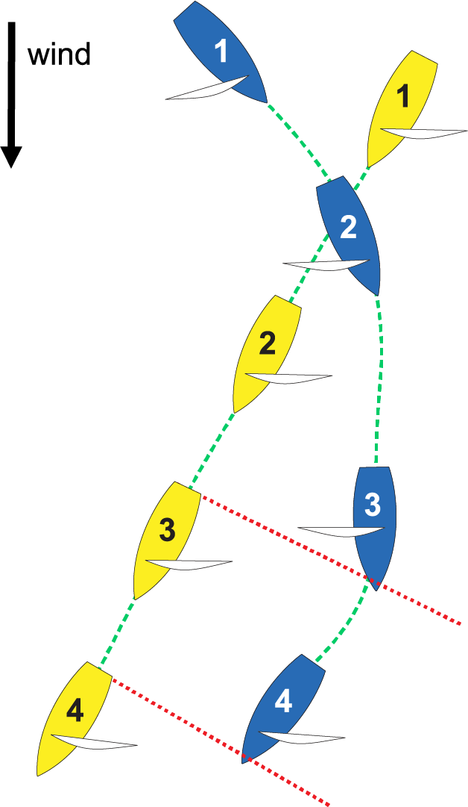
Downwind Leg
Between positions 1 and 2 Blue (port) passes clear astern of Yellow (starboard).
In position 3, Blue bears away creating an overlap. Because Blue & Yellow are both sailing > 90º off the wind, even though they are on opposite tacks they are overlapped.
In position 4, Blue gybes. As soon as her boom crosses centerline Blue & Yellow are immediately overlapped on the same tack.
Because Blue established her overlap from clear astern when the boats were on opposite tacks, rule 17 does not apply and Blue can luff to head to wind, but must give Yellow room to keep clear, under rules 15 and 16.1.

Slide 46


Leeward Mark
Yellow (starboard) is on the opposite tack and well behind Blue (port), but Yellow has an inside overlap when Blue enters the zone.

Slide 47
Leeward Mark
Giving Mark-Room and Keeping Clear
Green is the inside windward boat.
She does not have right-of-way (rule 11).
Blue and Yellow must give Green space to sail to the mark when her proper course is to sail close to it, and then space to round the mark as necessary to sail the course. (rule 18.2(b) & def. “mark-room”)

Slide 48

Leeward Mark
Giving Mark-Room and Keeping Clear
Green is the inside leeward boat.
She is the right-of-way boat (rule 11).
Because Yellow is in-between Green and Blue, and overlapped with both, Green is overlapped with Blue (see def. Clear Astern and Clear Ahead; Overlap).
Green and Yellow must gybe when it is their proper course to so do if the mark is not a gate mark (rule 18.4).

Slide 49

Leeward Mark
Position 1: Yellow (starboard) is the right-of-way boat. (rule 10)
Position 2: When Blue enters the zone, she is clear ahead of Yellow. Rule 18.2 (b) requires Yellow to give Blue mark-room.

Slide 50

Leeward Mark
Under rule 18.4 “when an inside overlapped right-of-way boat must gybe at a mark to sail her proper course, until she gybes she shall sail no farther from the mark than needed to sail that course. . . . “
Yellow must gybe at the mark.
Yellow may not luff away from the mark prior to gybing if that takes her farther from the mark than her proper course (rule 18.4).
If this is a wing mark then gybing right at the mark might be Yellow’s proper course.
If this is a leeward mark then making a tactical rounding (swing wide-cut close) might be Yellow’s proper course.
If this was a gate mark rule 18.4 would not apply.

Slide 51

Leeward Mark
The positions of Green, Yellow and Blue make it obvious that Red is outside the zone.
At position 2 Gray is overlapped with Red. (def. “overlap”)
Gray and Red continue to be overlapped when the first of them reaches the zone.
Red must give Gray mark-room.
(rule 18.2(b) & def. “mark-room”)

Slide 52

The Finish
The preamble to Section C of Part 2 turns Rule 18 off at a starting mark, but it does not turn it off at a finishing mark.
Rule 18.1(a) turns rule 18 off at a windward mark (including a windward finishing mark) when the two boats are coming into the mark on opposite tacks.
Rule 18.2(b) requires Yellow (outside) to give Blue (inside) mark-room.

Slide 53

The Finish
“A boat finishes when, after starting, and part of her hull crosses the finishing line from the course side. However, she has not finished if after crossing the finishing line she
(a) takes a penalty under rule 44.2
(b) corrects an error in sailing the course made at the line, or
(c) continues to sail the course.”
A boat finishes when she breaks the
plane of the finishing line.
(Position 2 for both boats.)
After finishing a boat must clear the
finishing line and marks. She is still racing until she does so (def. racing).
She may clear the line in either direction (rule 28.1).
A boat clears the finishing line and marks when no part of her hull, crew or equipment is on the
line, and no mark is influencing her choice of course. (Case 127)
(Position 3 for Blue/Position 4 for Yellow)

Slide 54

The Finish
If a boat touches a finishing mark before clearing the finishing line, she must complete a One-Turn Penalty and then sail completely to the course side of the line before finishing.
In this example, Blue completed her gybe (position 4) and completed her tack (position 9) then re-crossed the finishing line to finish.
A boat can complete her One-Turn Penalty anywhere, but after completing it she must sail completely to the course side of the line and finish.

Slide 55

The Finish
Rule 23.1 – “If reasonably possible, a boat not racing shall not interfere with a boat that is racing.”
At position 2 Blue has finished and is no longer racing. At position 3 she interferes with Yellow.
  Interference is adversely affecting a boat’s forward motion or maneuverability.
This applies both before and after racing.
Be careful where you sail; watch your
wind shadow and physical presence.
The Preamble to Part 2 limits penalties
against boats not racing to those under
rule 14 when injury or serious damage
occurs, or to those under rule 23.1.

Slide 56

Penalties
Rule 44 Penalties at the Time of an Incident
“A boat may take a Two-Turns Penalty when she may have broken one or more rules of Part 2 in an incident while racing. . . . However, . . .
(b) if the boat caused injury or serious damage, or despite taking a penalty, she gained a significant advantage in the race or series her penalty is to retire.” (rule 44.1)
“After getting well clear of other boats as soon after the incident as possible, . . .” (rule 44.2)

Slide 57

to the US Sailing Judges Committee for creating this presentation!

