Slide 1
Rule Situations at International Regattas
Dave Perry
Chairman, US Sailing Appeals Committee

Slide 4
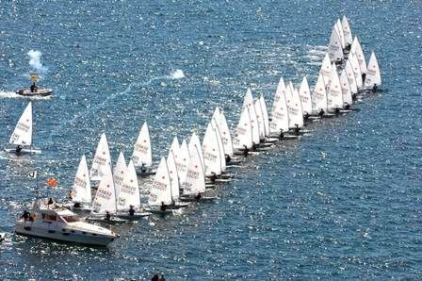

Slide 5
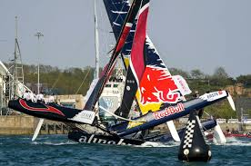

Slide 6
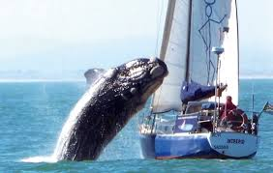

Slide 7
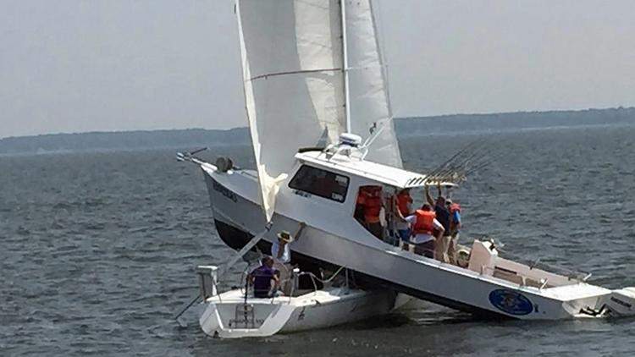

Slide 8
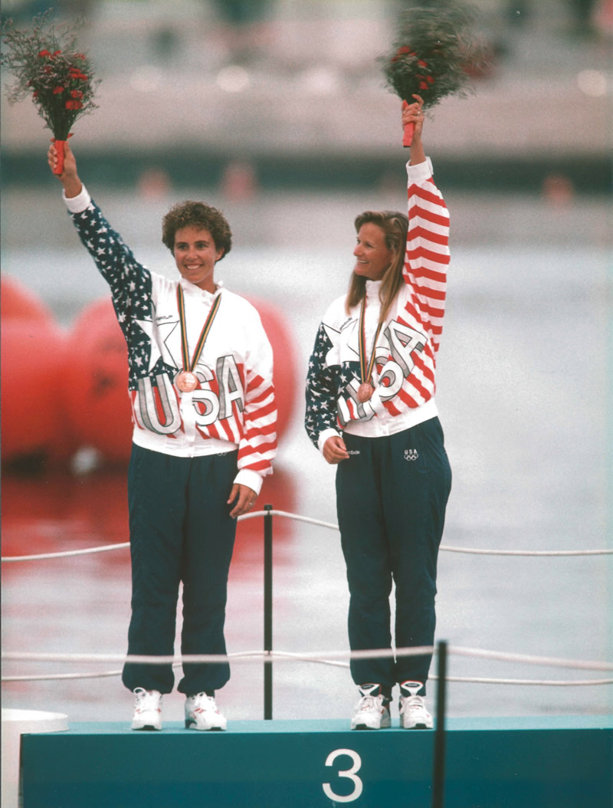

Slide 9
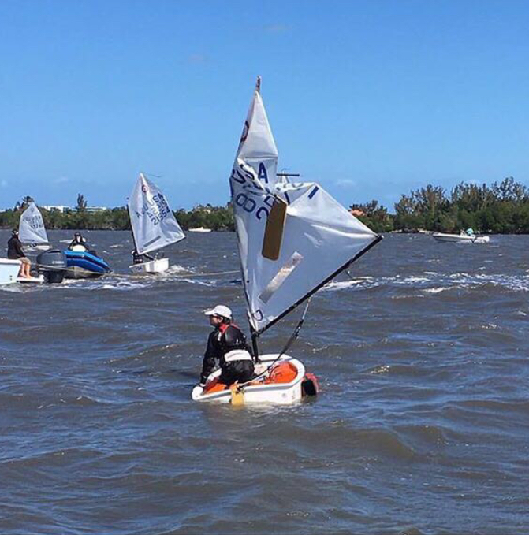

Slide 10
When a boat is in a protest or redress hearing, it could determine the outcome of the race. So be sure to prepare just as hard for a protest or redress hearing as you do for a race…because it *is* the race!

Slide 11
Before racing begins…
for both the Sailors and the Coaches
Study the Notice of Race and Sailing Instructions (SI’s)
Study any Prescriptions in effect
Study the Discretionary Penalties in the SI’s
Study the World Sailing Rule 42, Propulsion, papers (general and class-specific)
Study the rules for filing a protest or request for redress in the SI’s
Find out where the Jury Desk and hearing rooms are
Grab some protest forms
Find the Official Notice Board
Is there an electronic Official Notice Board?
10) Have a Rule Book and a copy of the WS Case Book
(or have them on your phone or iPad or computer, etc.)
11) Have a Protest / Redress Plan written up
12) Go over the Plan (keep in mind when there is a potential hearing
situation after the race, the sailors are commonly fatigue, hunger,
dehydration, emotions and time pressures in place)
13) Be sure the sailors and the coaches have each other’s cell numbers in
their phones

Slide 12
The Racing Rules of Sailing
Notes:
√ 2020 Update
180 pages +/- and only 4 RoW rules! Plus 4 limiting rules and mark room…

Slide 13
The Racing Rules of Sailing
Plus Winning in One-Designs

Slide 14
* Available from the App Store
* Search “US Sailing Bookstore”
* free for US Sailing members

Slide 15
The Racing Rules of Sailing
US Sailing website > Competition > Appeals
World Sailing Case Book link too

Slide 16
The Plan…Sailors
On the water…
Avoid situations that could end up in a protest!
If involved in an incident where there might be a protest, say the word “Protest” immediately after the incident and clearly identify which boat(s) you are protesting.
Take a quick look around for possible witnesses, and ask “did you see that?”
If required in the SI’s, tell the race committee boat as soon as you finish that you intend to protest boat XYZ, and get a confirmation (you may need to wait for a quiet moment).
On the way in, talk the situation through with your crew, or go over it in your head – try to recall the key pieces of information and sequence of events. If with your Coach, have them make some notes.

Slide 17
On shore…
1) Remain calm and focused and eat and drink something…have the attitude that this is important and you need to be on your A Game.
2) Immediately let your Coach know of the possible situation (you are protesting, or may be protested, or may be requesting redress).
3) Immediately check in with possible witnesses (whether you are protesting or being protested). Ask them if they saw the incident and if so, what did they see. Don’t put words in their mouth, but be sure to get a clear idea of what they saw. Ask if they’ll witness for you, and find out how to reach them to give them the hearing details.
4) If you are asking for redress, immediately check with anyone you need to get information or testimony from (see #3 above).
5) If you are going to file, or possibly file, a protest or request for redress, get started immediately on filling out the form (if a singlehanded sailor, ask a teammate to put your boat away). Do not miss the time limit for filing (your Coach should know that time).
6) Meet with your coach and anyone else who may be helpful in preparing for the hearing.
7) Confirm the hearing details (when & where?).

Slide 18
8) Whether protesting or being protested, write down the key facts and information, in chronological order:
Wind and current strength and direction
What happened, starting 30 seconds or so before the incident
Boat numbers correct?
What happened and what was said immediately after the incident and for the next 20 seconds or so
Decide what the Key Facts are (the ones that will decide the protest in your favor) and think about how you will prove those to the Jury (witnesses, timing, location of hole in your boat, etc.)
Write down the applicable rules (numbers and titles) and any World Sailing Cases that might apply (check the Case Book Index of Rules)
Draw a careful and clear diagram of the positions of the boats a couple lengths before the incident, in the incident, and a couple lengths after the incident. Insert your witness’ boat as well.
9) If protesting, fill out the protest form clearly and carefully. The form makes a big first impression on the Jury. Draw diagrams precisely. Try to number the diagram positions and use the same number for the corresponding written description on the form. Have your Coach proof the form before submitting it.
10) If you are being protested, ask the Jury Secretary for a copy of the protest against you. You have a right to receive that, and a right to time to prepare for the hearing (rule 63.2).

Slide 19
11) Brainstorm the possible questions the other boat or the Jury will ask you in the hearing; role play how you will answer them. Brainstorm questions you might ask the other boat(s).
12) Change into dry clothes and be at the hearing room area 10 minutes before your hearing, in case the Jury is looking for you. Do what you can to have your witness(es) there with you.
13) Bring your notes and a rule book into the hearing, plus your diagram for the Jury if you are being protested.

Slide 20
The Plan…Coaches
On the water…
Be observant. Try to see the incidents that might involve your sailors in a protest (start and mark roundings are the most likely places). Notice problems that might result in redress (starting line issues, moving marks, close time limit finishes, etc.). Take photos, make notes. Notice potential witnesses (coaches, drones in the air, race committee boats, media?).
Talk with your sailors right after finishing, if possible, to see if there are any potential situations. If yes, talk it through with them. Take notes. Listen for Key Facts and information (possible witnesses, etc.).
Do whatever is feasible to get the sailor(s) potentially involved in the hearing ashore as quickly as possible (run a sailor in, tow the boat in, etc.)

Slide 21
On shore…
1) Remain calm and focused (your sailors may not be ;>). Have some food and drink for your sailors (and you).
2) Know all the pertinent information (when does Protest Time end, where is the Jury Desk, etc.).
3) Have a couple of protest forms available, and some pens, etc.
4) Help the sailors decide what to do (go through with a protest or request for redress –
what are the Pro’s and Con’s). You may want to have a quiet chat with the other sailor’s coach.
5) Help the sailors locate potential witnesses, etc.
6) Help coordinate people to put the sailors’ boats away so the sailors can focus on the protest/request.

Slide 22
7) Have a spot for the sailors to sit and talk through the situation, and fill out the form, etc.
8) Proof the form and make sure it is filed in the correct place and within the Protest Time Limit (do not be late – that is an almost guaranteed way to have the protest not heard).
9) Whether your sailor is protesting or being protested, be sure to have them write down what happened. It is very strong for the protestee to hand the Jury a diagram of what happened as well (the protestor is doing so on their protest form). The sailors can bring their notes and rule book into the hearing.
10) If your sailor is being protested, be sure you get a copy of the protest against them. They have a right to receive that, and a right to time to prepare for the hearing (rule 63.2).
11) Finalize your sailor’s testimony and any rules and Cases that might apply.
12) Role play the types of questions the other boat or Jury may ask, and have your sailor go through their testimony as if you were the Jury. Help them be clear, concise and compelling. Remind them to talk slowly as English may not be the first language for many of the Judges.
13) Go with your sailor to the hearing room area. Help them remain positive and focused. Help to make sure the witnesses are there too.

Slide 23
14) Be sure to physically check the ONB about 15 minutes after the Protest Time Limit expires (check the SI’s for when the Jury will post hearing notices).
15) Remind your sailors to be polite, and to thank the Jury for their time, regardless the outcome.

Slide 25
Dave Perry David Dellenbaugh 203.556.1095 203.520.1370 davperry@optonline.net supercarrot@optonline.net

